Slide 1
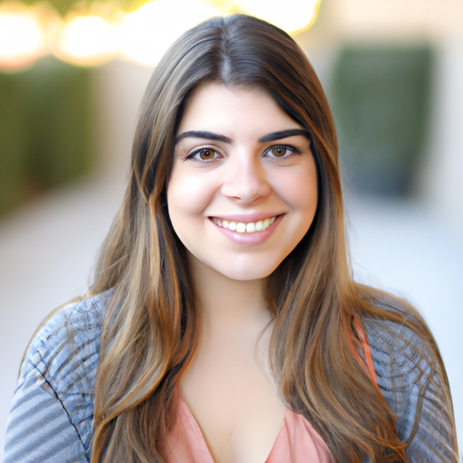
“I’m a full-timer at New York University who is in search for better food services.”
Goals
To receive orders successfully based on her requests
To gain better mobile experience in making and following up with orders
Improve efficiency and include additional features for filtering pickup locations
Frustrations
“It is difficult to make sure the timing is right. If the food arrives too early, I have to wait. If the food arrives too late, my hot items get cold.”
“Sometimes, orders are incomplete or incorrectly filled.”
“Sometimes, the app is not functioning properly.”
“Sometimes, the orders are missing.”
Kathryn Harris
Age:
Education:
Hometown:
Family:
Occupation:
18
Student, 1st year
New York, NY
Lives in apartment
Student Aide
Kathryn is studying at New York University. As a full-time student, she attends 5 courses for her current semester. Also, as a student aide, she works for the Computer Science department. Her schedule is very tight, and her orders sometimes are not processed successfully. She feels that by improving the app performance she will be satisfied with the orders she made remotely.

Slide 2
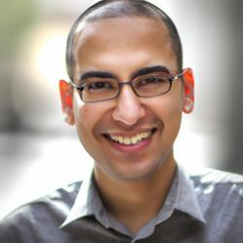
“I really want to create a lovely place for me and my family to enjoy the best food-tasting experience.”
Goals
Include additional food preferences that suits his needs
To locate food trucks close to his hometown
To gain better mobile experience in making and following up with orders
Frustrations
“There are no food preferences toward mobile ordering. The flavor of my favorite food is too spicy to handle.”
“The order takes too long to arrive to the pickup location.”
“There is no feature that finds the food truck closest to me.”
“Sometimes, the orders are wrong or incompleted.”
Mark Finnigan
Age:
Education:
Hometown:
Family:
Occupation:
30
Bachelor (Business)
Hoboken, NJ
1 parent, 3 siblings
Data Analyst
Mark is a data analyst, living and working remotely in his hometown in New Jersey. Most of the time, he prepares and serves meal to the family by himself when he has enough grocery. Sometimes when he is busy, or during the special days (holidays and birthdays), he gets food from the food truck. Because of the family health conditions and ages, he hopes there are food preferences toward mobile ordering. Also, because he frequently gets his food from his favorite food truck that is far away from his hometown, he also hopes to find food trucks that are close to his location.

